Slide 1
Analyzing Health Equity Using Household Survey Data
Lecture 10
Multivariate Analysis of Health Survey Data
Notes:
In this lecture, we discuss some issues that generally deserve consideration when undertaking multivariate analysis of survey data for the purpose of learning about health sector inequality or inequity.
First, we distinguish between descriptive and causal analysis and identify the statistical issues that are relevant in each case.
Second, because health data invariably derive from complex sample surveys, we consider the consequences of sample design for estimation and inference. To illustrate, we use a variety of methods to conduct multivariate analysis of child nutritional status in Vietnam.
In the following lecture, we present some of the estimators most commonly used in analysis of health data.

Slide 2
Why multivariate analysis?
Health sector inequalities measured through bivariate relationship b/w health vbl. and SES
To go beyond measurement of inequalities, need multivariate analysis, e.g.
  Finer description of inequality through standardisation for age, gender, etc.
  Explanation of inequality through decomposition of covariance
  Identification of causal relationship b/w health vbl. and SES
Notes:
The most basic description of health sector inequality is given by the bivariate relationship between a health variable and some indicator of socioeconomic status (SES) captured, for example, by the concentration curve and index.
For a finer description, the analyst might want to standardize for demographic factors, such as age and gender (see lectures 5 and 15 ). Or, the analyst might want to explain the inequality through decomposition into its constituent parts (see lectures 12 and 13 ). More ambitiously, the analyst might want to test for the existence of a causal relationship between a health variable and SES and to examine the nature of any causality. All of these tasks require moving from bivariate to multivariate analysis.

Slide 3
Descriptive analysis
Aim is to describe SES related inequality in health
How does health vary with SES, conditional on other factors?
OLS describes how mean of health varies with SES, conditional on controls
Modelling issues (OVB, endogeneity) are irrelevant
But, cannot place causal interpretation on estimates
Notes:
As always, the appropriate statistical approach depends on the question to be answered. If the analyst is interested in simply describing SES-related inequality in health or health care, then statistical modeling issues are irrelevant. The analyst simply wants to describe how health varies with SES, conditional on other factors such as age, gender, and so on. Ordinary least squares (OLS) can be used to describe how the mean of health varies with SES, conditional on whatever factors the analyst wants to control for. The more variables the analyst controls for, the finer is the description of the relation between health and SES. Issues of omitted variable bias and endogeneity are not relevant. Of course, such simplicity comes at a price. The analyst cannot place any causal interpretation on the estimates. A significant OLS coefficient does not mean that SES has an effect on health, even if the analyst controls for a multitude of observable covariates. It simply means that health is observed to vary as SES varies. There is inequality.
The standardization and the decomposition methods covered in chapters 5 and 15 and in chapters 12 and 13, respectively, are examples of exploratory, or even explanatory, but still descriptive analysis. They are used to describe the distribution, primarily the mean, of health or health care conditional on SES, age, gender, and so forth.

Slide 4
Causal analysis
For causal inference need modelling approach
Appropriate model and estimator depends upon degree of detail required
To identify total causal effect and not its mechanisms, reduced form is adequate e.g. decomposition
To separately identify direct and indirect effects, need structural model
Notes:
1. If the analyst wants to draw causal inferences, then the approach has to move from a descriptive one to a modeling approach. Causal relationships can arise through a number of pathways. Models and estimators vary in sophistication with the degree of detail of the causal relationship the analyst is aiming to uncover. For example, maternal education can affect child health either directly, through knowledge of healthy behavior, or indirectly, through preferences for child health. If the analyst is interested simply in whether educating women is an effective means of raising child health, irrespective of the mechanism through which it works, then the statistical model, and estimator, can be quite simple. A reduced form approach (see below) is adequate. However, if the analyst wants to establish whether educated mothers are better able to raise healthy children, abstracting from preference effects, then the model, as well as the methods, has to be more sophisticated. A structural model (see below) must be developed and estimated.

Slide 5
Household production model
Health “produced” from inputs
Inputs selected conditional on (unobservable) health endowments
So, inputs endogenous
RF demand relations → combined technological impact and behavioural response
To isolate technological impact, must confront endogeneity of inputs:
  Instrumental variables
  Panel data
Notes:
The household production model (Becker 1964, 1965) provides a useful framework for causal analysis of health variations (Grossman 1972a, 1972b; Rosenzweig and Schultz 1982, 1983; Schultz 1984; Wagstaff 1986). According to this approach, health, which is of intrinsic value, is “produced” by the household through the input of time and goods, such as food and medical care. The household selects such inputs given its members’ physiological predispositions to good/bad health. These health endowments are observable to the household but not to the analyst. As a consequence, regressing outcomes, such as health, on inputs, such as medical care, will not render unbiased estimates of the causal impact of the latter because both the inputs and the outcomes reflect the values of the health endowments.
The most popular empirical strategy is to estimate reduced form demand relations. That is, to regress health outcomes on (exogenous) determinants of health inputs, for example, medical care prices. The resulting coefficients reflect both “technological” relationships between inputs and outcomes, and household preferences for health relative to other “goods.” From such a reduced form health function it is not possible to conclude anything about the technological impact of a variable on health. For example, the relationship between female wage rates and child health reflects both the incentive effects of the wage on household time allocation and the effect of time use on child health. Nevertheless, for certain policy questions, reduced form estimation is appropriate. For example, say the analyst wants to know how population health will respond to an increased availability of medical care facilities, taking account both of the technological impact of medical care on health and the behavioral response with respect to utilization. Then, estimation of the reduced form correlation of area variations in medical facilities with individual levels of health is adequate.
If estimates of the health production technology are desired, then the problems of omitted variable bias and unobservable heterogeneity must be confronted. For example, regressing health on health care use, while omitting education, will give a biased estimate of the impact of health care in the likely instance that it is correlated with education. Resolution of the problem demands a sufficiently rich data set. The problem of heterogeneity bias arises from the unobservable health endowment, which induces correlation between the observable and unobservable components of a model of health determination. With cross-section data, correction of the resulting bias requires the availability of instruments, that is, variables that affect the health inputs but, conditional on these, not health itself. Appropriate instruments vary with the specific inputs being considered. At a general level, instruments used in the estimation of health production functions commonly come from geographic variation in market prices, from family endowments, for example, land rights, and from characteristics of public health programs at the regional level (Rosenzweig and Schultz 1983).
Instrumental variable (IV) estimation is fraught with danger. It is easy to claim that an endogenous regressor has been instrumented. It is somewhat more difficult to find a valid instrument. IV estimation should therefore be subjected to stringent testing (Bound, Jaeger, and Baker 1995; Staiger and Stock 1997). The variables proposed as instruments should be significant in a reduced form for the health input. Further, overidentification tests should be used to check whether exclusion of the proposed instruments from the health equation is justified.
Panel data have two important advantages with respect to estimation of health production functions. First, with data on the same individuals at different points in time, it is easier to account for the effect of unobservable health endowments, which generate much of the endogeneity problem. For example, the fixed effects estimator (see below) eliminates the time invariant unobservable effects and is consistent. The second important advantage of panel data is that they allow the time dynamics of health relationships to be investigated. The determination of health is essentially a dynamic process; health today reflects experiences of the past. For causal analysis of the determination of health, panel data are top priority.

Slide 6
Sample design and area effects
Health data come from complex surveys
Stratified sampling – separate sampling from population sub-groups (strata)
Cluster sampling – clusters of observations not sampled independently
Over sampling – e.g. of poor, insured
Area effects – feature of population but importance depends on sample design
Notes:
We discussed complex sample designs in lecture 2, but only in relation to how the sample design should be taken into account in conducting inference with respect to population means.
We now consider whether and how sample design should be taken into account in conducting multivariate analyses.
A related issue, which we consider, is that of area effects—controlling for all observable determinants, area of residence exerts an independent effect on health. Such effects are characteristics of the population itself, but their sample importance depends on the sample design.

Slide 7
Standard stratified sampling
Population categorised by relatively few strata e.g. urban/rural, regions
Separate random sample of pre-defined size selected from each strata
Sample strata proportions need not correspond to population proportions → sample weights (separate issue)
In pop. means differ by strata, standard errors of means and other descriptive statistics should be adjusted down
Notes:
1. See lecture 2 on these issues.

Slide 8
Stratification and modelling
Exogenous stratification – OLS is consistent, efficient and SEs valid
Endogenous stratification – adjust SEs
Relative to simple SEs, adjustment can be important
Relative to corrections for hetero. and clustering, adjustment is usually modest
May want intercept/slope differences by strata
Notes:
Adjustment of standard errors for stratification is not necessary in (nondescriptive) regression analysis and a wide variety of other multivariate modeling approaches, provided stratification is based on variables that are exogenous within the model (Wooldridge 2001, 2002). For example, say a sample stratified by urban/rural is used to estimate the determinants of child nutritional status, measured by height-for-age z-score. Provided, conditional on the regressors, unobservable determinants of height-for-age and of city dwelling are uncorrelated, the OLS estimator, for example, is consistent and efficient, and the usual standard errors are valid.
In the likely presence of heteroscedasticity, the analyst would want to make the standard errors robust, but that is another issue.
If stratification is based on an endogenous variable, however, then standard errors should be adjusted (Wooldridge 2002).

Slide 9
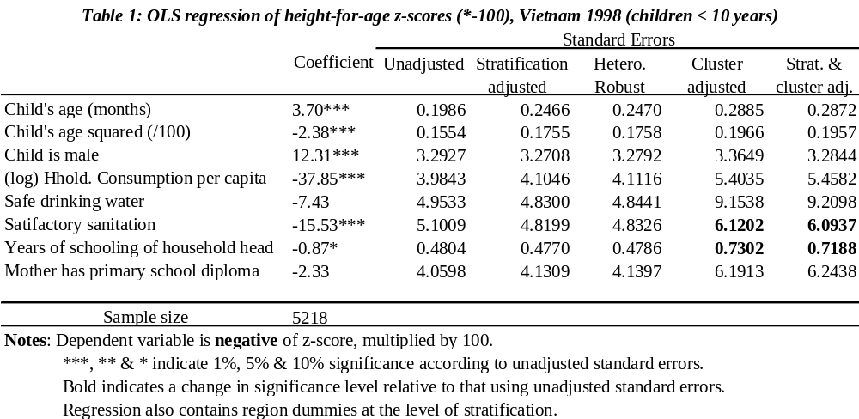
Example of adjustment to OLS standard errors
Notes:
In the table below we present OLS coefficients from a regression of height-for-age z-scores (see chapter 4 ) using a sample of Vietnamese children under 10 years of age. The data are from the 1998 Vietnam Living Standards Survey (VLSS), which was stratified by 10 regions. The specification of the regression is based on that used by Wagstaff, van Doorslaer, and Watanabe (2003) (see also chapter 13). The dependent variable is actually the negative of the z-score (multiplied by 100), such that a positive coefficient indicates a negative correlation with height.
In addition to the OLS point estimates, we present standard errors (SEs) calculated with various degrees of adjustment. Relative to simple OLS SEs (column 2), adjustment for stratification alone (column 3) tends to inflate the SEs appreciably, but not dramatically. In some cases, the adjustment is slightly downward. In no case does the adjustment change the level of significance of the coefficient. In this example, making the SEs robust to heteroscedasticity of general form (column 4) has a very similar effect to that of adjusting for stratification.
Besides stratification, the VLSS has a cluster sample design. Adjusting SEs for cluster sampling but not stratification (column 5) has a greater impact than stratification adjustment. In all cases, as expected, the adjustment is upward and in two cases it actually changes the level of significance.
Finally, we adjust for both stratification and clustering (column 6). Comparing columns 5 and 6, it is apparent, for this example, that given adjustment for clustering, the marginal impact of stratification adjustment is small. In most cases, but not all, this marginal adjustment is downward. In no case does adjustment for stratification change the level of significance relative to that obtained by adjusting for clustering alone.
For this example, adjusting standard errors for clustering appears to be more important than adjustment for stratification. Although care must be taken not to draw general conclusions from an example, this is consistent with what is generally found in empirical work.

Slide 10
Cluster sampling
2-stage (or more) sampling process
  Clusters sampled from pop./strata
  Households sampled from clusters
Observations are not independent within clusters and likely correlated through unobservables
Consequences and remedies depend on the nature of the within cluster correlation
Notes:
Note, clusters are sampled, large in number and contain relatively few observations. By contrast, strata are pre-determined (not sampled), few in number and contain many observations.
Within cluster correlation exists in the population but the sample design increases the sample important relative to that which would arise from a simple random sample.

Slide 11

Exogenous cluster effects
(1)
If
have random effects model.
Conventional estimators e.g. OLS, probit, etc. are consistent
but inefficient and SEs need adjustment.
Can accept inefficiency and adjust SEs. In Stata, use option
cluster(varname)
For efficiency, must estimate and take account of within-
cluster correlation, e.g. GLS, random effects probit.

Slide 12

Endogenous cluster effects
(1) with
is the fixed effects model
Regressors correlated with composite error → conventional
estimators are inconsistent.
Need to purge cluster effects from composite error.
In linear model – cluster dummies, differences from cluster
means or first differences.
Binary choice – fixed effects logit.
Having purged cluster effects, is no need to correct SEs
Notes:
For example, in a regression of individual health on health service utilization, we would expect the latter to be correlated with the unobservable cluster-specific quality of those services. In instances in which there is such dependence, regressors are correlated with the composite error and standard estimators are inconsistent. The analyst must purge the cluster effects from the composite error.
Statement that there is no need to adjust the standard errors is correct if the cluster effects are correctly specified as linearly additive. Otherwise, they will not be purged by the transformation and there is a continued need to adjust the SEs.

Slide 13
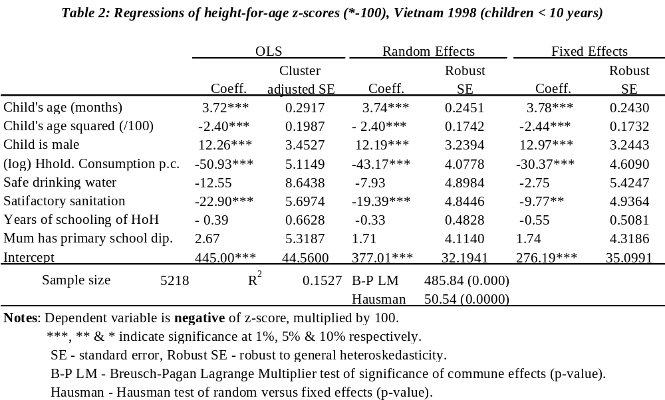
Comparison of estimators for a cluster sample
Notes:
In VLSS, cluster samples drawn at level of both commune and village. PSU is commune and restrict attention only to correlation at this level.
Compare 3 estimators: OLS with SE correction, RE (FGLS) and FE (within-group).
3. The Hausman test can be used to choose b/w random and fixed effects. Test of null of independence b/w cluster effects and regressors.

Slide 14
Stata computation
OLS with cluster corrected SEs
regr depvar varlist, cluster(commune)
OLS with cluster and stratification corrected SEs
svyset commune, strata(region)
svy: reg depvar varlist
Random effects (FGLS)
xtreg depvar varlist, re i(commune)
Fixed effects
xtreg depvar varlist, fe i(commune)

Slide 15

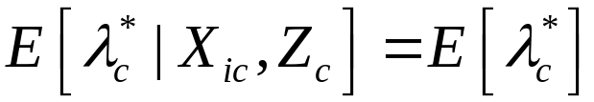
But community effects can be interesting
Exogenous community effects
Define, the model becomes
(2)
Condition for consistency:
SEs need to be adjusted for within-cluster correlation.
Efficiency loss from OLS may not be large.
This REM also known as the hierarchical model.
Notes:
The strategies outlined above for dealing with cluster samples are appropriate when the analyst is interested exclusively in the determinants of health/health care at the individual level. In this case, the cluster sample design is a problem to be overcome. But cluster, or community, effects can be more than nuisance parameters. With respect to health inequality, for example, area variations in health, and their determinants, are of genuine interest. Not least because implementation of public health policies at the community, rather than the individual, level is often more feasible. In this case, a cluster sample design is an advantage rather than a problem. It facilitates examination of cross-community differences in health and their determinants, particularly if the household survey is accompanied by a community-level survey providing information on characteristics of the community.
1. In this case, the analyst can explore the determinants of area variation in health outcomes or utilization by including community-level variables, if available, in the model.

Slide 16
Endogenous community effects
With a single cross-section, not possible to include community level regressors
With panel data, can do this
In cross-section:
  Run fixed effects and obtain estimates of the community level effects
  Regress these effects on community level regressors
Notes:
In cases in which the (unobservable) community effects are correlated with individual-level regressors, it is not possible to include community-level variables in a model to be estimated from a single cross section. With a dummy variable approach, the community variables would be perfectly correlated with the community dummies. With a fixed-effects approach, community variables would be wiped out of the model along with the unobservable community effects. If one has panel data, then these problems are avoided provided there is sufficient across-time variation in the community-level variables. With a single cross section, a feasible two-stage approach in a linear context is to estimate a fixed-effects model, obtain estimates of the community effects, and then regress these on community-level variables. In the first stage, the bias arising from the community effects is removed from the individual-level analysis of, say, health determination. In the second stage, sources of community variation in health are examined.

Slide 17
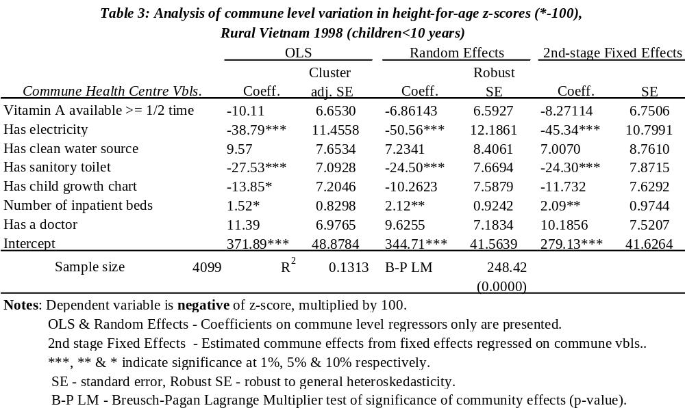
Example explanation of community effects
Notes:
Before we saw that commune effects are an important source of variation in height-for-age z-scores of Vietnamese children. The VLSS offers the opportunity to uncover factors underlying these commune effects through the examination of data from commune-level surveys that accompanied, and can be linked to, the household survey data. For demonstration purposes, we limit attention to the characteristics of commune health centers (CHCs). The analysis is necessarily restricted to children living in rural areas and small towns because the commune surveys were conducted in those areas only.
Again we compare OLS, random effects, and fixed effects. In the case of OLS and random effects, the estimates are obtained from entering the CHC characteristics directly into the individual-level regressions. We present, in the table below, the estimates for the CHC regressors only. Estimates for the individual-level regressors are similar to those given in the table in box 10.2. For the fixed-effects model, we take the two-stage approach outlined above. In the table, we present results from the second stage regression of the estimated commune effects on the CHC characteristics. The first stage estimates are similar to those in the table 2
The results indicate a lower prevalence of stunting in communes in which the CHC has electricity, a sanitary toilet and, at marginal significance, a child growth chart. The number of inpatient beds available in a CHC and, at lower significance, the employment of a doctor is positively correlated with the prevalence of stunting. These latter results may reflect the targeting on resources in the communes of greatest need.

Slide 18
Stata computation for 2-step procedure
Run fixed effects and save predictions of the fixed effects
xtreg depvar varlist, fe i(commune)
predict ce, u
Use the between-groups panel estimator to regress these
predicted effects on community level regressors
xtreg ce varlist2, be i(commune)

Slide 19
Sample weights
Stratification, over-sampling and non-response can all lead to a sample that is not representative of the population
Sample weights are the inverse of the probability that an observation is a sample member
Sample weights must be applied to get unbiased estimates of population means, etc. and correct SEs
Should also be applied in “descriptive regressions”
Notes:
1. The probability of observing an individual in a survey may differ from the probability that the individual is randomly selected from the population. There are a number of reasons for this. The survey may be stratified, with strata sample proportions differing from respective population proportions. For example, there may be oversampling of the urban population. Besides sample design, differential nonresponse will lead to a sample that is not representative of the population. For those reasons, survey data typically come with a set of sample weights that, for each observation, indicate the (inverse of the) probability of being a sample member. In a standard stratified sample with differential sampling by strata, weights or expansion factors are given by the ratio of the population size of each stratum to its sample size.

Slide 20
Should weights be applied to estimate a model?
If selection is on exogenous factors, unweighted estimates are consistent and more efficient than weighted
  Simple (robust) SEs are OK
Otherwise, weighting required for consistency
  If stratification and weights, take account of both in computation of SEs
  If no stratification, apply conventional SE formula to weighted data.

Slide 21

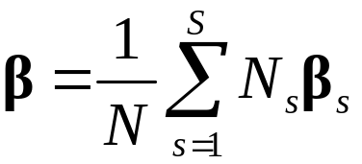

What if there is parameter heterogeneity in population?
Say we are interested in an average, such as
Consistent estimate is the population weighted average of
the sector specific OLS estimates
Unweighted OLS on the whole sample is not consistent for
the average parameter.
But neither is weighted OLS on the whole sample.

Slide 22
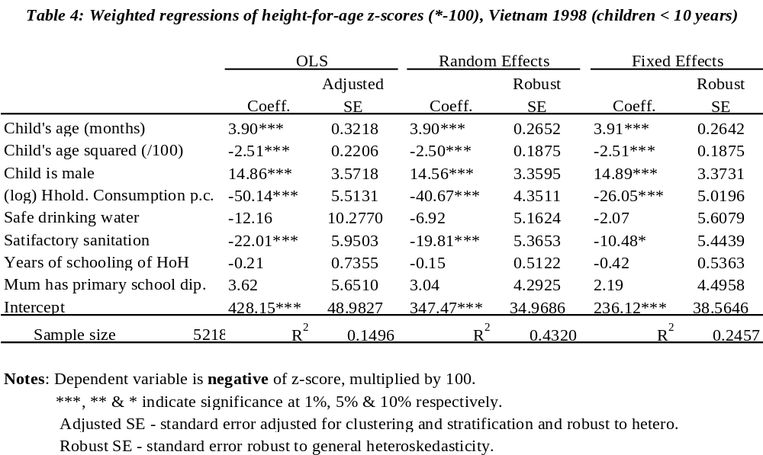
Example application of sample weights
Notes:
We reproduce the analysis of table 2, but with sample weights applied to all estimators. One other difference is that the OLS standard errors are adjusted for stratification because, within a modeling approach, the logic for applying sample weights and for adjusting for stratification is the same. That is, selection on an endogenous variable.
By comparing the estimates presented in the table below with those given in table 2, it is apparent that the application of sample weights makes very little difference to the results. A possible explanation is that the application of sample weights is not necessary in this particular example. That is, differential sampling is exogenous, and so the unweighted estimators are consistent.

